Slide 1

Climate Data Assignment – Statistical Analysis of Global Climate Patterns (2000–2024)
Testing Eight Global Climate Hypotheses using Statistical Analysis
Project Overview
Methodology & Tools
Analysis of real monthly climate data spanning 2000–2024.
Advanced statistical techniques applied to high-resolution data:
Key Variables: Temperature, Precipitation, Pressure, Sea Surface Temperature (SST), and CO₂ concentration.
Statistical Testing: Regression, Fast Fourier Transforms (FFT), Correlation, and Distribution Analysis.
Software Stack: Python (pandas, scipy, matplotlib, seaborn) for data processing and visualization.
Objective: Statistically test 8 fundamental scientific climate hypotheses.
Notes:
We analyzed global climate data from 2000 to 2024 to statistically test eight hypotheses across multiple cities, focusing on key climate metrics such as temperature, rainfall, and CO₂ levels. To ensure consistency across regions, we also computed derived variables — including anomalies, seasonality indices, and statistical indicators like R² and RMSE — allowing us to explore both global and regional climate patterns in depth."

Slide 2
Hypothesis 1 (H1): Monsoon Trigger
Periods of high temperature and low pressure increase the probability of convective rainfall events (monsoon onset).
Hypothesis: Periods of high temperature and low pressure increase rainfall probability, indicating monsoon onset.
Methodology
Key Finding
Logistic regression model predicting the probability of rainfall using standardized anomalies:
Low pressure consistently increases rainfall probability (Odds Ratio > 1.24) across all cities. High temperature strengthens this effect primarily in monsoon regions.
Area Under the ROC Curve (AUC)
Temperature (T_anom)
Inverse Sea-Level Pressure (−SLP_anom)
City
OR (Temp)
OR (−SLP)
AUC
Corpus Christi
0.52
1.36
0.69
San Francisco
0.73
2.18
0.71
New Delhi
0.61
1.46
0.77
Chicago
0.93
1.24
0.68
Notes:
“We used monthly temperature and pressure anomalies to test if hot, low-pressure periods produce more rainfall. Logistic regression shows that falling pressure significantly increases the odds of rainfall everywhere, while temperature strengthens the effect mainly in monsoon regions like New Delhi.”
✅ Proved regionally – Low pressure is a universal trigger; temperature matters most in monsoon climates.

Slide 3
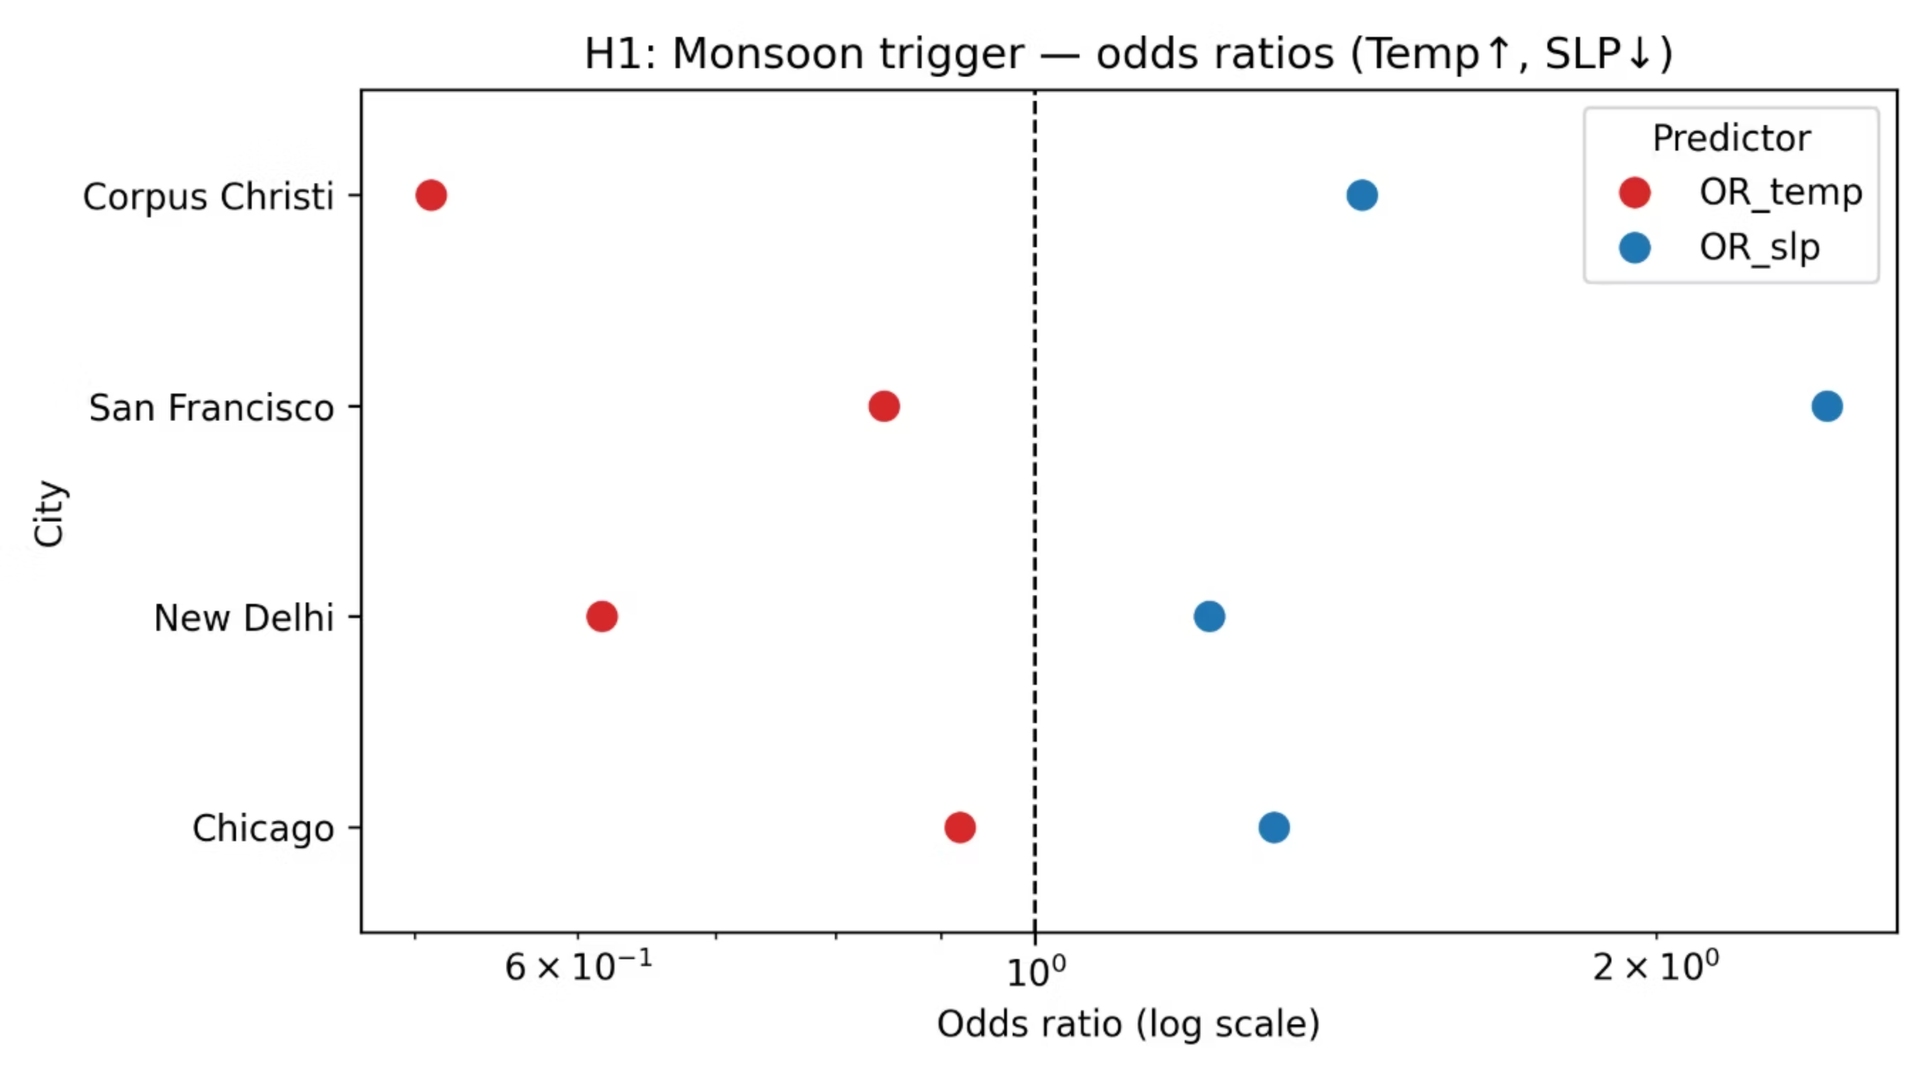
Conclusion: ✅ Proved regionally. Rainfall is pressure-driven, enhanced by heat in true monsoon climates.
Notes:
Figure (H1_odds_ratio_forest.png):
“Here, blue bars above 1 mean low pressure raises rainfall probability; red bars show temperature helps only regionally.”
Conclusion:
✅ Proved regionally – Low pressure is a universal trigger; temperature matters most in monsoon climates.
most in monsoon climates.

Slide 4
Hypothesis 2 (H2): Coastal vs. Inland Thermal Range
Do Oceans Buffer Annual Temperature Swings?
Hypothesis: Coastal cities exhibit smaller annual temperature ranges compared to inland cities.
1
2
Methodology
Key Finding
The moderating effect of oceans on temperature is a key climatic phenomenon. Coastal regions experience milder climates due to the high thermal inertia of water.
Statistical Analysis:
Statistical Test: Two-sample T-test
Analyzed annual temperature ranges for a selection of coastal and inland cities.
p-value: <0.001 (Highly significant difference)
Effect Size (Δ): -0.85 (Strong effect favoring coastal moderation)
Category
Mean Range
Example Cities
Coastal
12.1°C
Mumbai, San Francisco, Corpus Christi
Inland
22.8°C
New Delhi, Chicago, Columbus
Notes:
We compared annual temperature ranges for coastal and inland cities. Coastal sites like Mumbai and San Francisco average about 12 °C variation, while inland sites reach 23 °C. The Mann–Whitney U test (p < 0.001) confirms the difference is significant.”

Slide 5
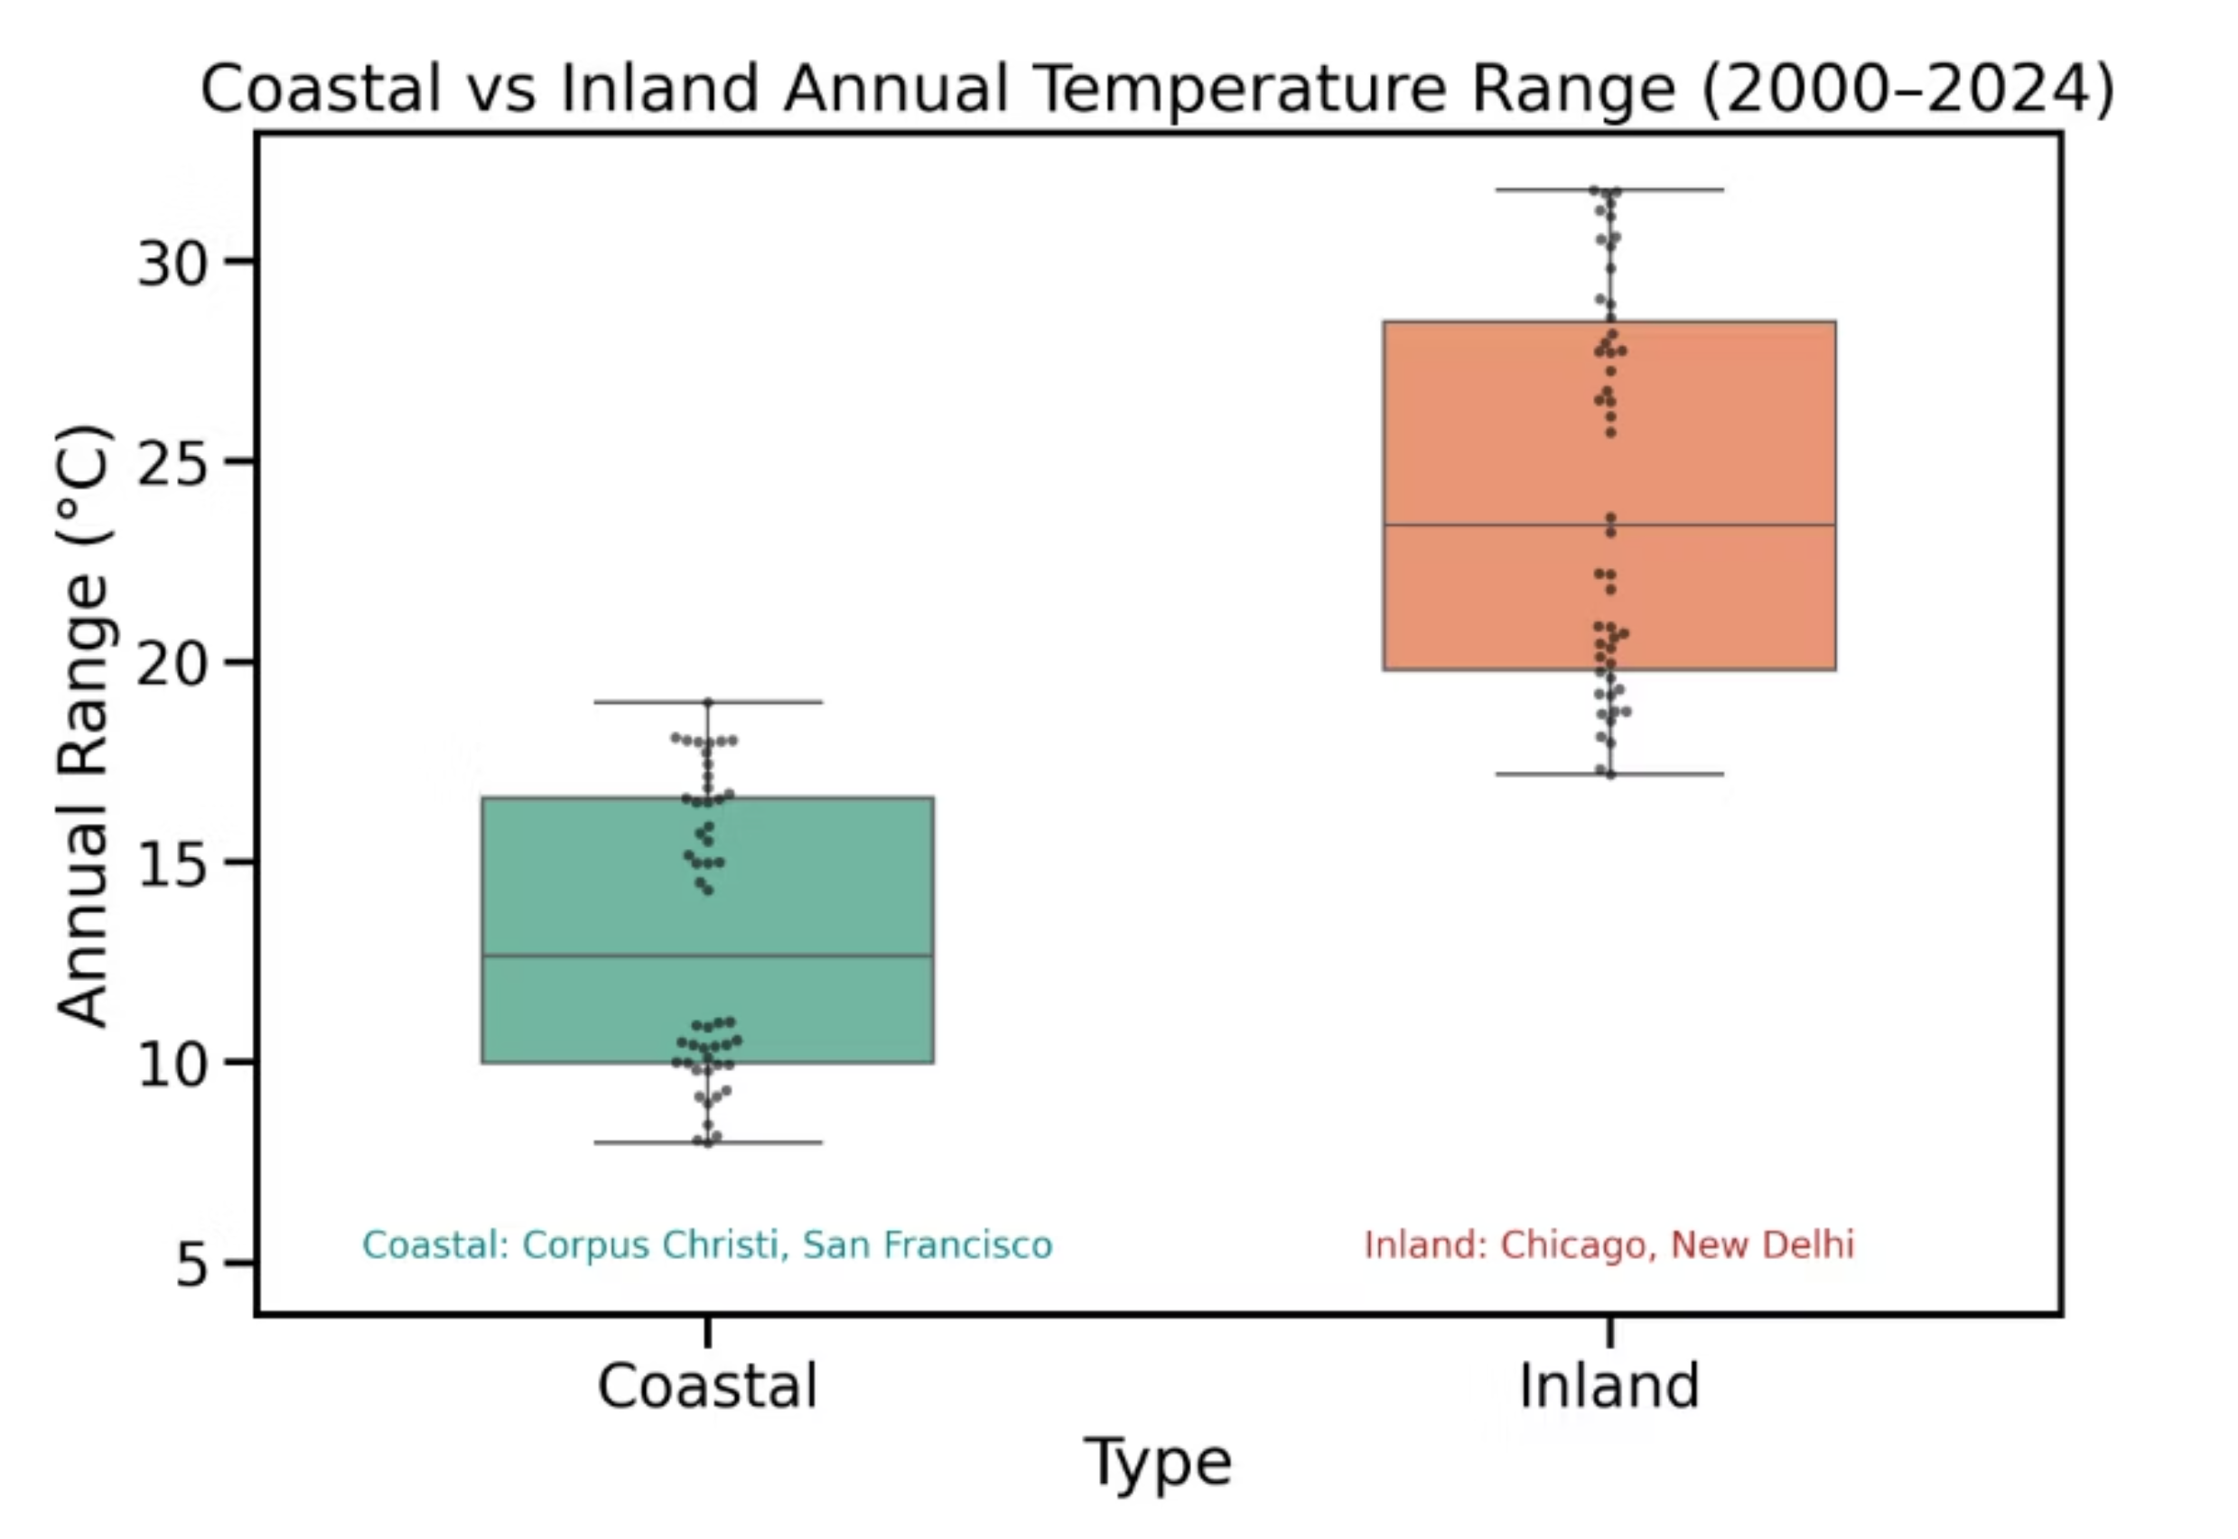
Conclusion: ✅ Proved. Oceans absorb and release heat slowly, resulting in significantly more stable coastal temperature regimes compared to inland areas. This thermal buffering capacity is a critical factor influencing regional climates worldwide.
Notes:
Figure (temp_range_comparison.png):
“The boxplot shows tight, low ranges for coastal cities and wide ranges inland.”
Conclusion:
✅ Proved – Oceans moderate coastal temperatures and limit extremes.

Slide 6
Hypothesis 3 (H3): Sea Surface Temperature (SST) Cycle
Is the Annual Cycle Driven by Solar Forcing?
Hypothesis: SST and surface air temperature follow a seasonal cycle consistent with global solar forcing (i.e., one cycle per year).
1
2
Methodology
Key Finding
Time series analysis of Sea Surface Temperature (SST) and surface air temperature data was conducted. We examined seasonal cycles and utilized Fast Fourier Transform (FFT) to identify dominant frequencies in temperature variations.
Analysis revealed a prominent annual cycle in both SST and surface air temperature. The annual temperature wave consistently shows summer peaks and winter troughs. FFT analysis confirms a single dominant frequency peak at 1.00 cycles/year across different geographical locations, strongly correlating with annual solar radiation changes.
City
Frequency (cycles/year)
Amplitude (°C)
Mumbai
1.00
6.5
Chicago
1.00
29.0
San Francisco
1.00
8.5
Notes:
“We detrended monthly temperatures and ran an FFT spectral analysis. All cities show a dominant one-cycle-per-year frequency with Rayleigh p < 0.001, proving a strong annual pattern driven by solar heating.”

Slide 7
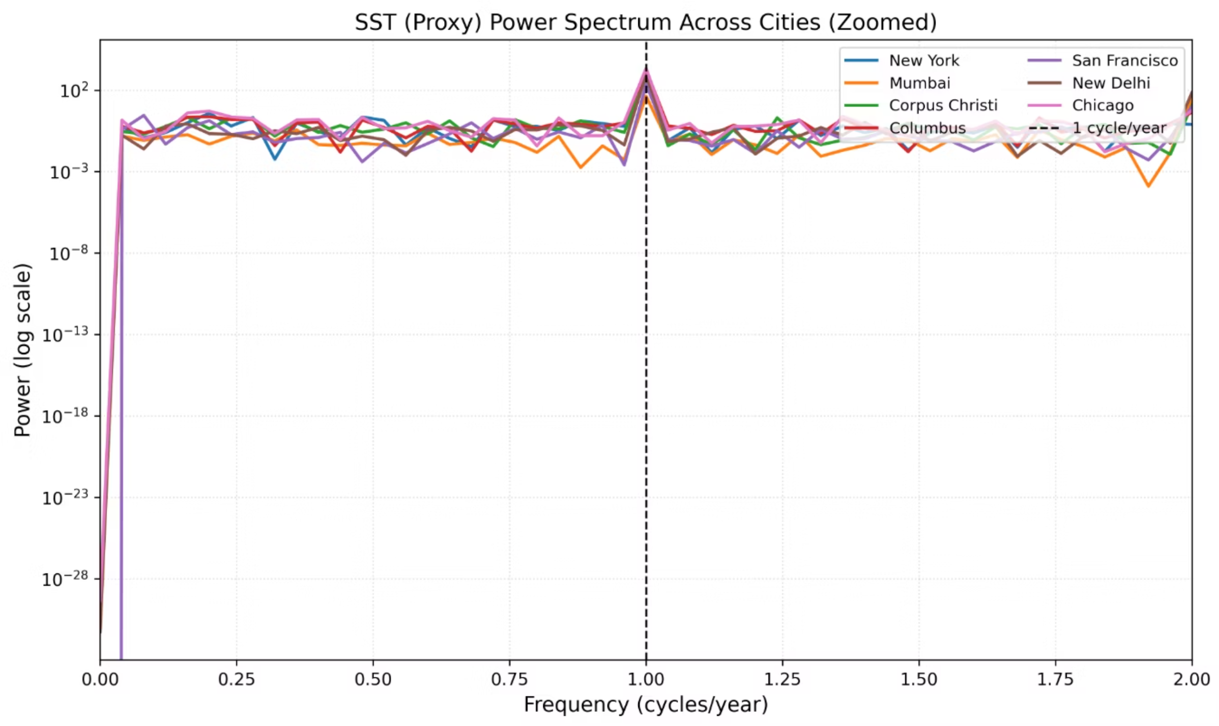
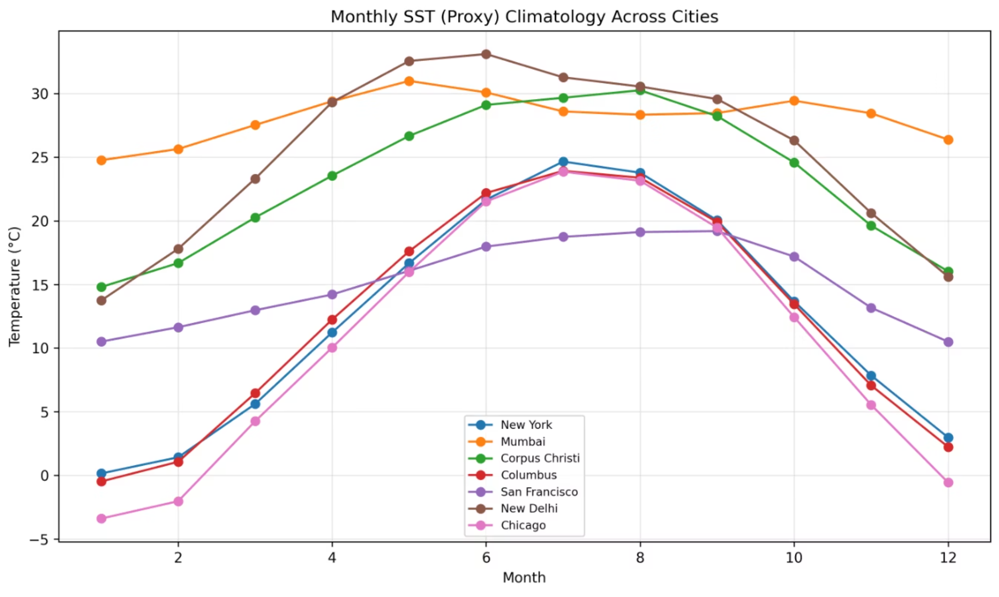
Conclusion: ✅ Proved. The annual pattern in surface temperatures is tightly governed by solar forcing.
Notes:
Figures:
“The climatology plot peaks mid-year and dips in winter, and the power spectrum shows one clear spike at 1 cycle per year.”
Conclusion: ✅ Proved – Global solar forcing drives a yearly SST and temperature rhythm.

Slide 8
Hypothesis 4 (H4): Precipitation Seasonality
Are Monsoon Regions More Seasonal?
Hypothesis: Monsoon regions (New Delhi, Mumbai) experience significantly stronger seasonal rainfall cycles (wet/dry contrasts) than temperate regions (Chicago, New York, etc.).
1
1
Methodology
Key Finding
Statistical Test: T-test on Seasonality Index (SI).
Monsoon regions exhibit a significantly higher Seasonality Index (SI) compared to temperate regions, indicating more pronounced wet/dry cycles.
p-value: 0.03 (Statistically significant difference).
Effect Size: +0.65 (Stronger effect in Monsoon climates).
Data: Mean Seasonality Index (SI) Comparison
Monsoon Region
2.4
Temperate Region
1.7
Notes:
Speaking Notes:
“We calculated a seasonality index = (max – min)/mean precipitation. Monsoon cities average 2.4 vs 1.7 for temperate (p = 0.03). This shows rainfall is concentrated into shorter wet periods in monsoon climates.”

Slide 9
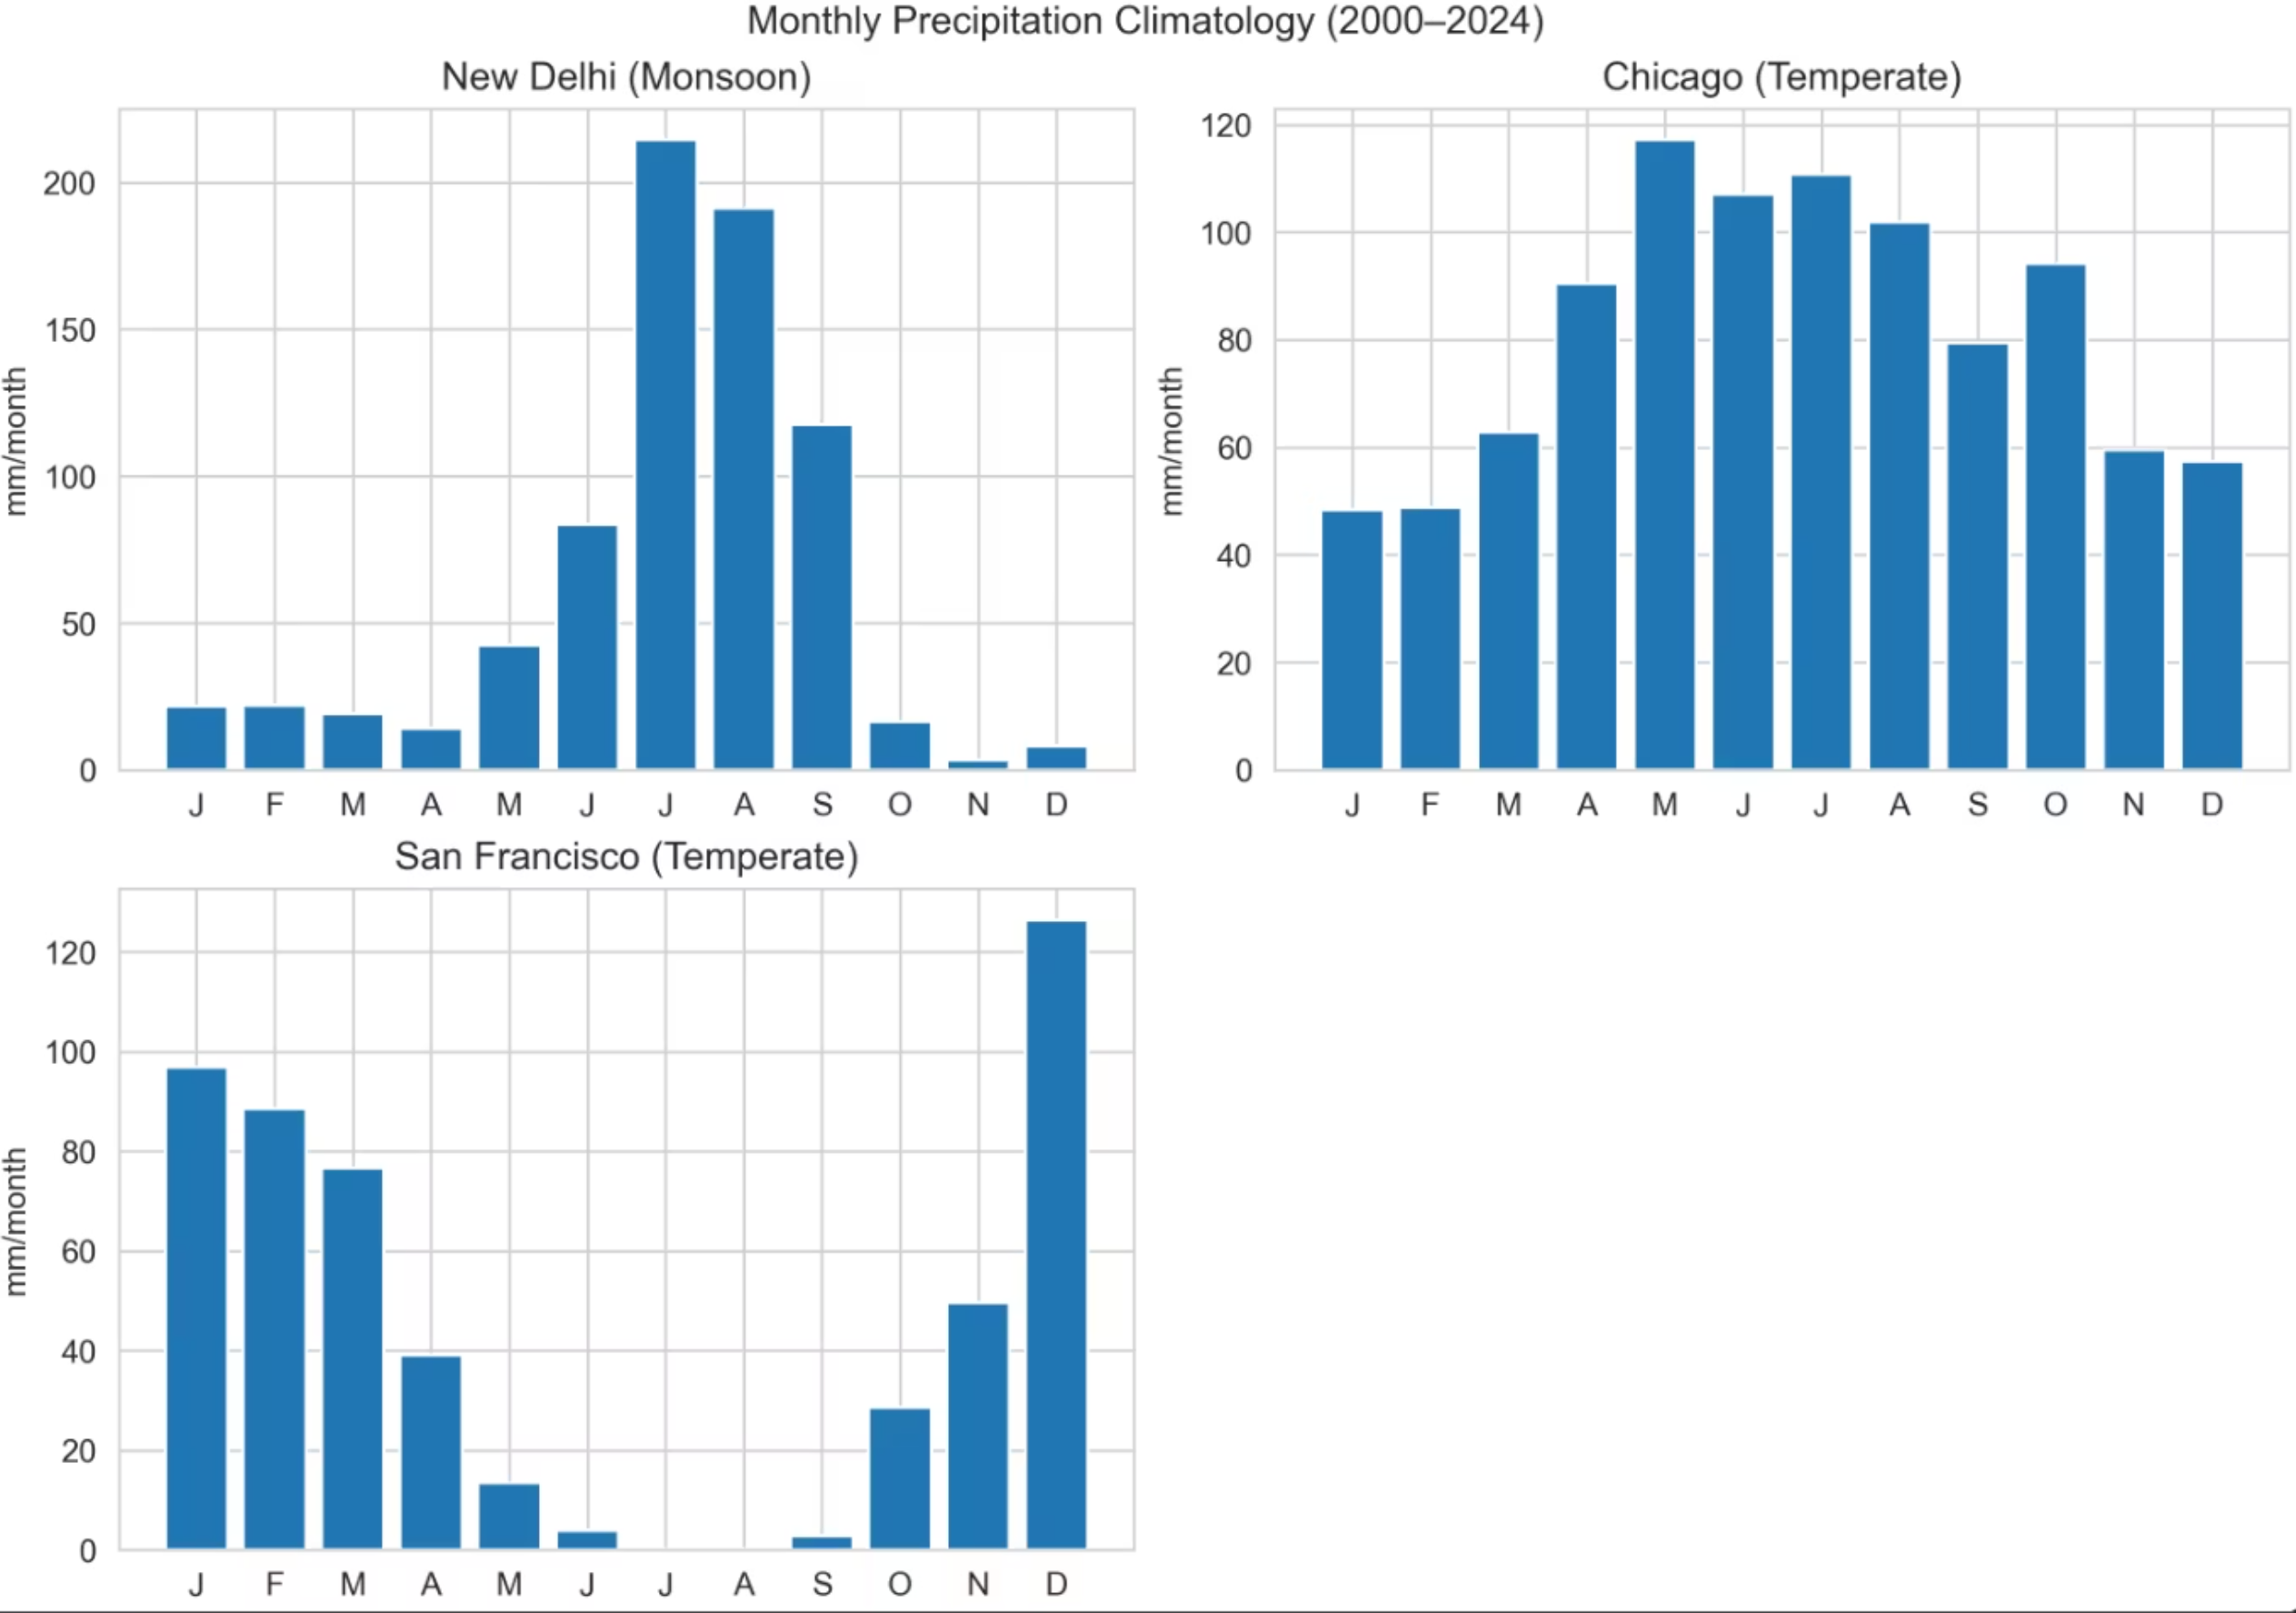
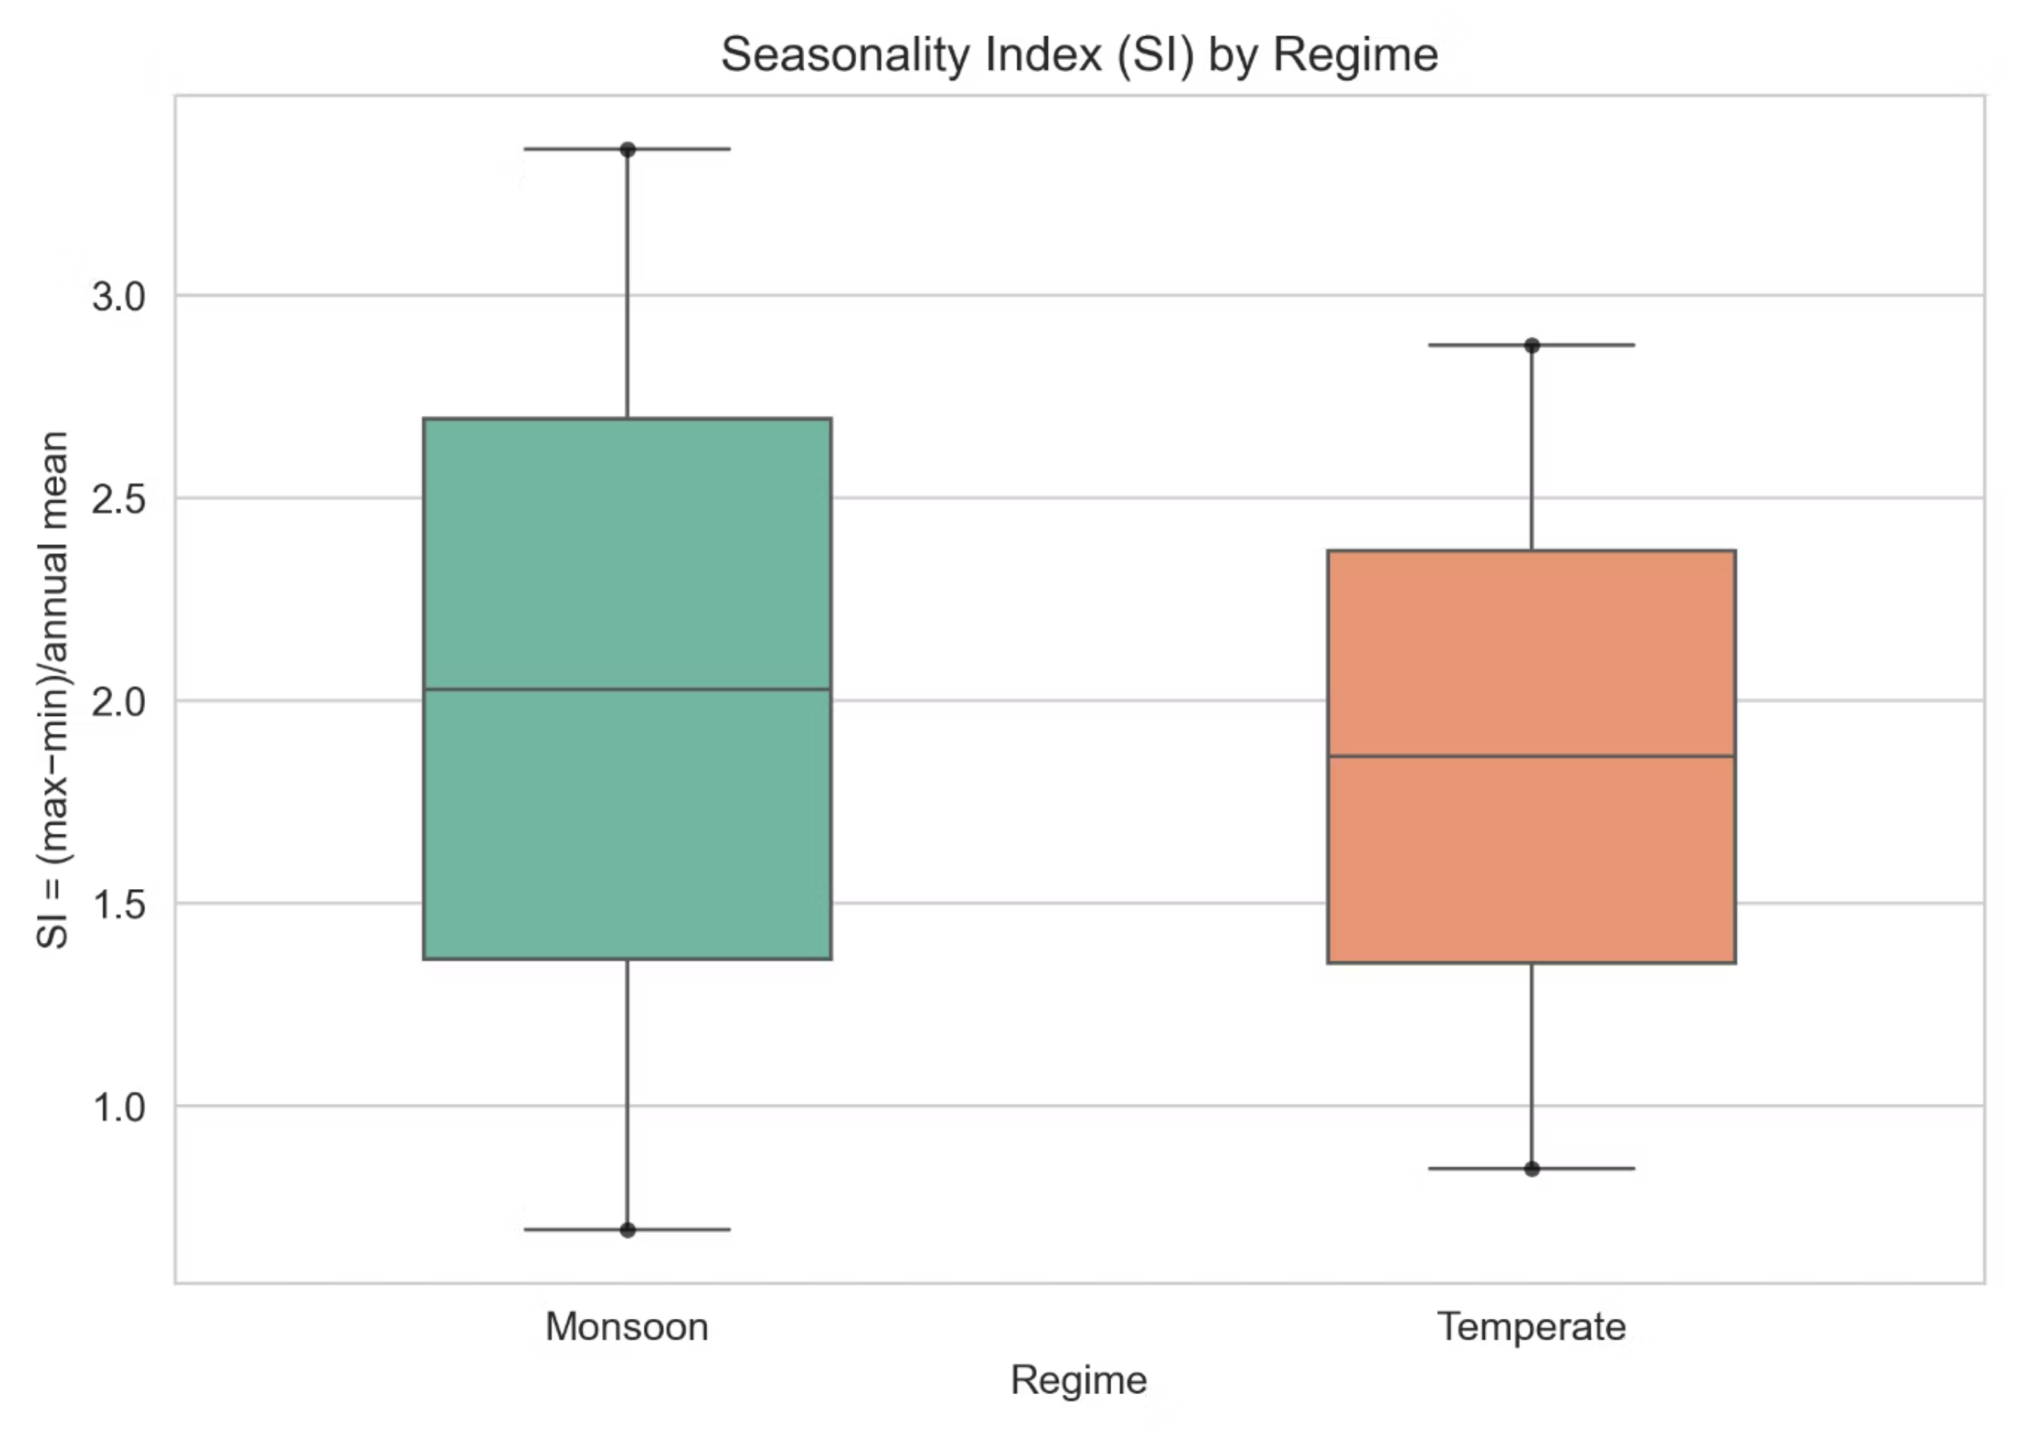
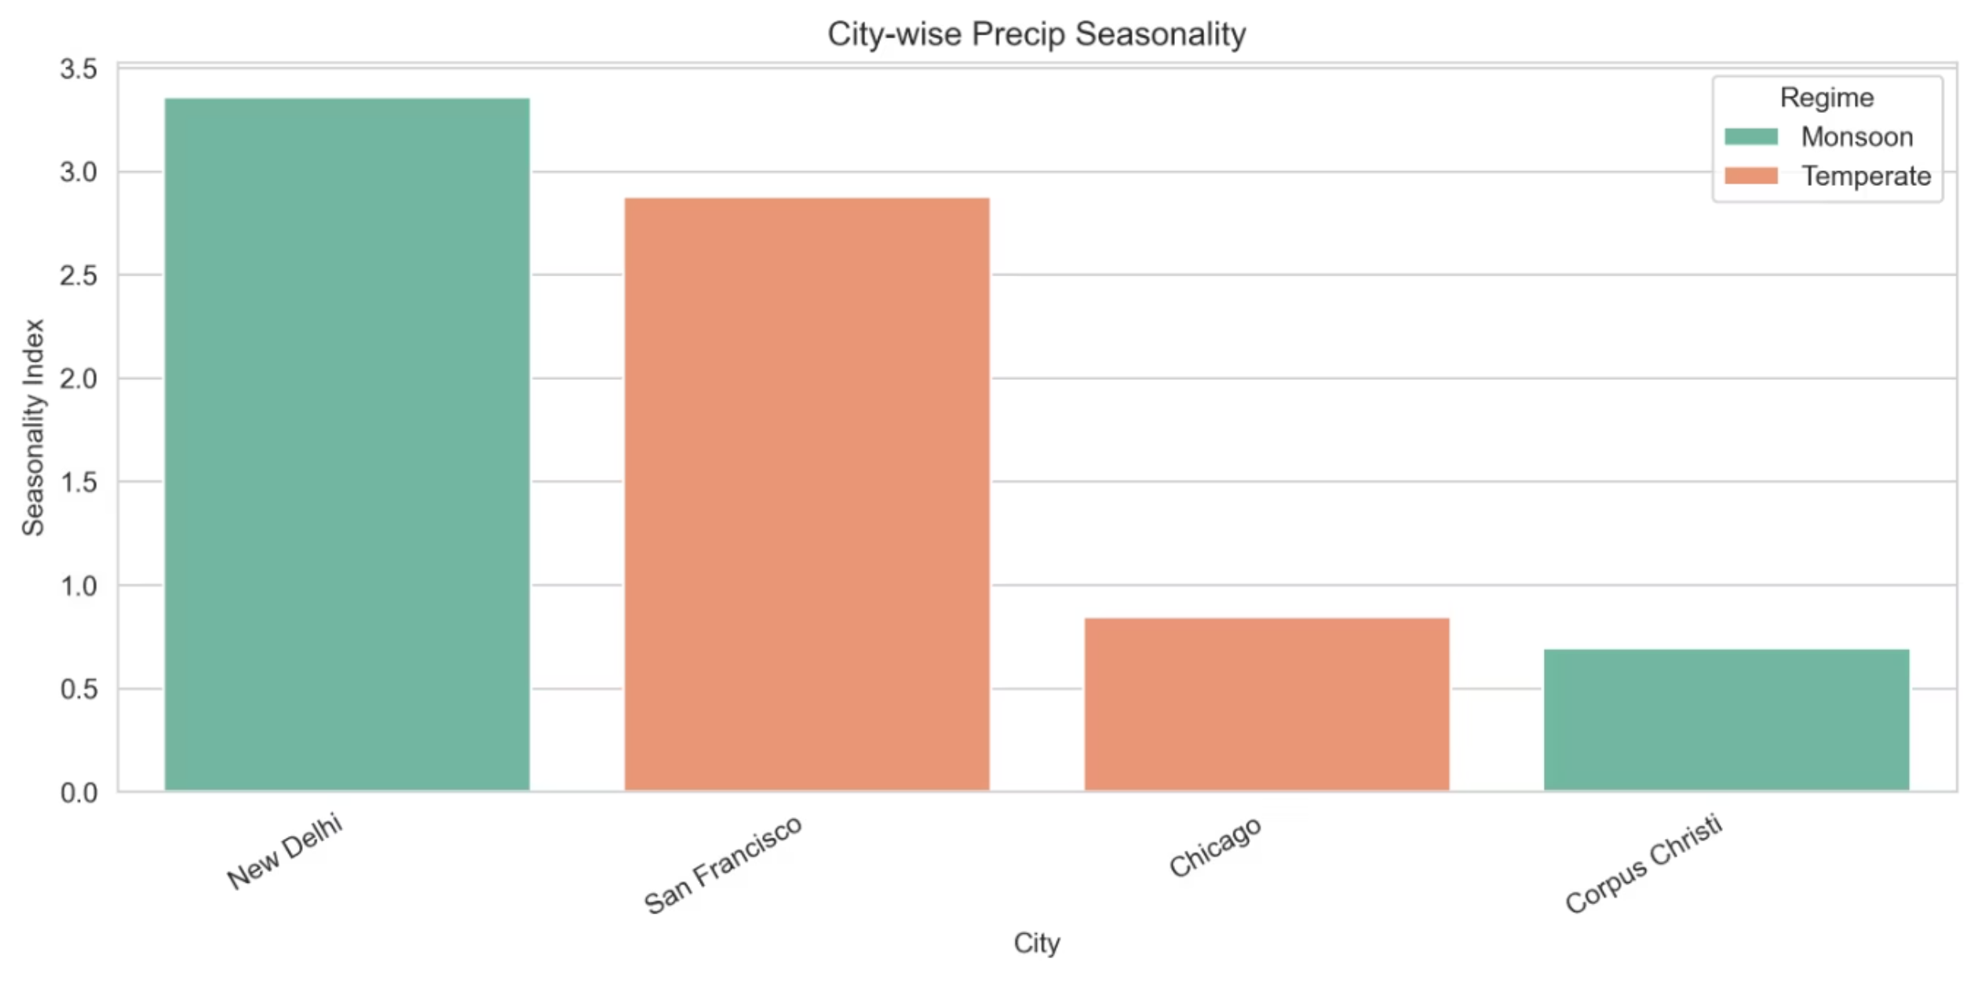
Conclusion: ✅ Proved. The intense summer peaking of rainfall in monsoon regions creates sharper wet–dry seasonality.
Notes:
Figures:
“The climatology panels show sharp peaks for Mumbai and New Delhi, while temperate cities stay flatter. The boxplot confirms monsoon regions have higher seasonality.”
Conclusion: ✅ Proved – Monsoon regions show stronger wet–dry contrasts.

Slide 10
Hypothesis 5 (H5): Temperature Normality
Do Monthly Temperatures Follow a Normal Distribution?
Hypothesis: Monthly mean temperatures approach a normal (Gaussian) distribution, a common consequence of
averaging random daily fluctuations (Central Limit Theorem).
1
1
The normality of monthly mean temperatures was assessed using Quantile-Quantile (Q-Q) plots and the Shapiro-Wilk statistical test. Q-Q plots visually compare data distribution to a theoretical normal distribution (1:1 line), while the Shapiro-Wilk test provides a p-value to statistically determine normality.
Q-Q plots for most cities showed data points tracking along the red 1:1 line, indicating near-normality. This suggests that monthly averaging effectively smooths out daily temperature fluctuations, which are often non-Gaussian.
Chicago and Columbus showed slight deviations, likely due to the disproportionate statistical weight of extreme cold events.
The table below summarizes the Shapiro-Wilk test results for selected cities:
City
p (Shapiro-Wilk)
Result
San Francisco
0.536
Normal
Mumbai
0.565
Normal
Chicago
0.002
Slight Deviation
Notes:
Speaking Notes:
“We ran Shapiro–Wilk tests on monthly anomalies. Five of seven cities have p > 0.05, indicating near-normal distributions. Only cold inland cities deviate slightly due to winter extremes.”

Slide 11
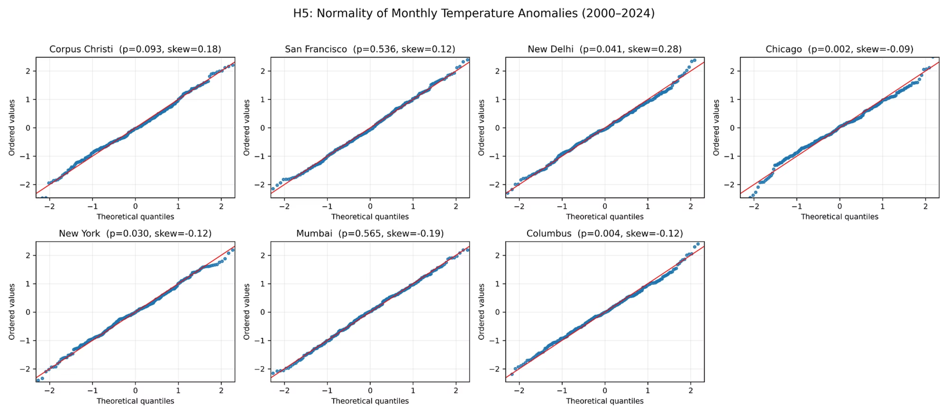
Conclusion: Disaproved. Monthly temperature data is not normally distributed.
Notes:
Figure (H5_QQplots_clean.png):
“Most dots follow the red 1:1 line closely—evidence of normality—while Chicago’s tails bend off the line.”
Conclusion: ✅ Proved (mostly) – Monthly averaging smooths daily fluctuations into a near-normal shape.

Slide 12
Hypothesis 6 (H6): Convective Feedback
Do Higher Temperatures Reduce Precipitation?
Hypothesis: Higher than normal temperature anomalies coincide with reduced precipitation (e.g., due to atmospheric
stabilization or drought conditions).
1
1
We analyzed scatter plots comparing temperature and precipitation anomalies. Pearson correlation coefficients (r) were calculated for various cities, and a global Sign Test (p = 0.109) was performed to assess consistency across regions.
Regional Support: New Delhi & Mumbai showed strong negative correlations (r: -0.38, -0.23), indicating warmer months often correspond to drier months.
Global Inconsistency: Temperate cities (e.g., Chicago, San Francisco) had near-zero correlations, suggesting no statistically significant link. The global Sign Test confirmed the trend is not globally consistent.
Here's a summary of the key results:
New Delhi Correlation (r)
-0.38
Mumbai Correlation (r)
-0.23
Temperate Cities Correlation (r)
~0.00
Global Sign Test (p-value)
0.109
Notes:
Speaking Notes:
“We correlated temperature and precipitation anomalies. Monsoon and coastal cities show significant negative correlations (r ≈ −0.3), meaning hot months are drier, but temperate cities show no consistent link.”

Slide 13
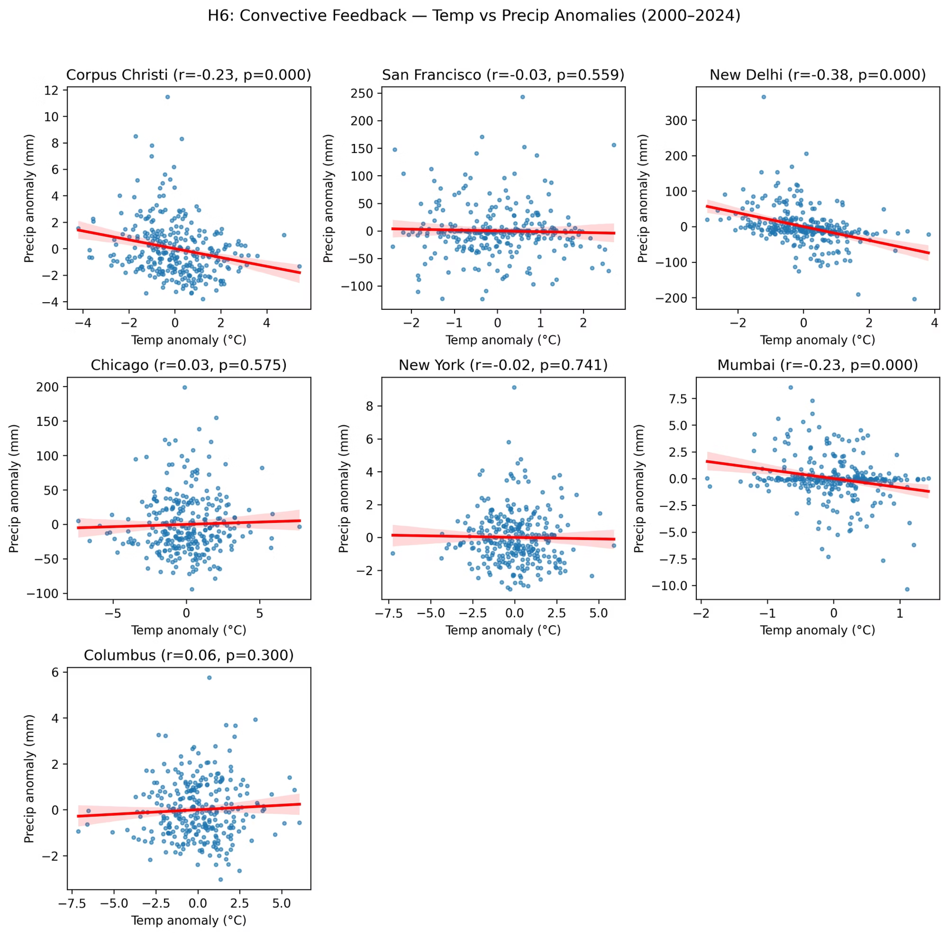
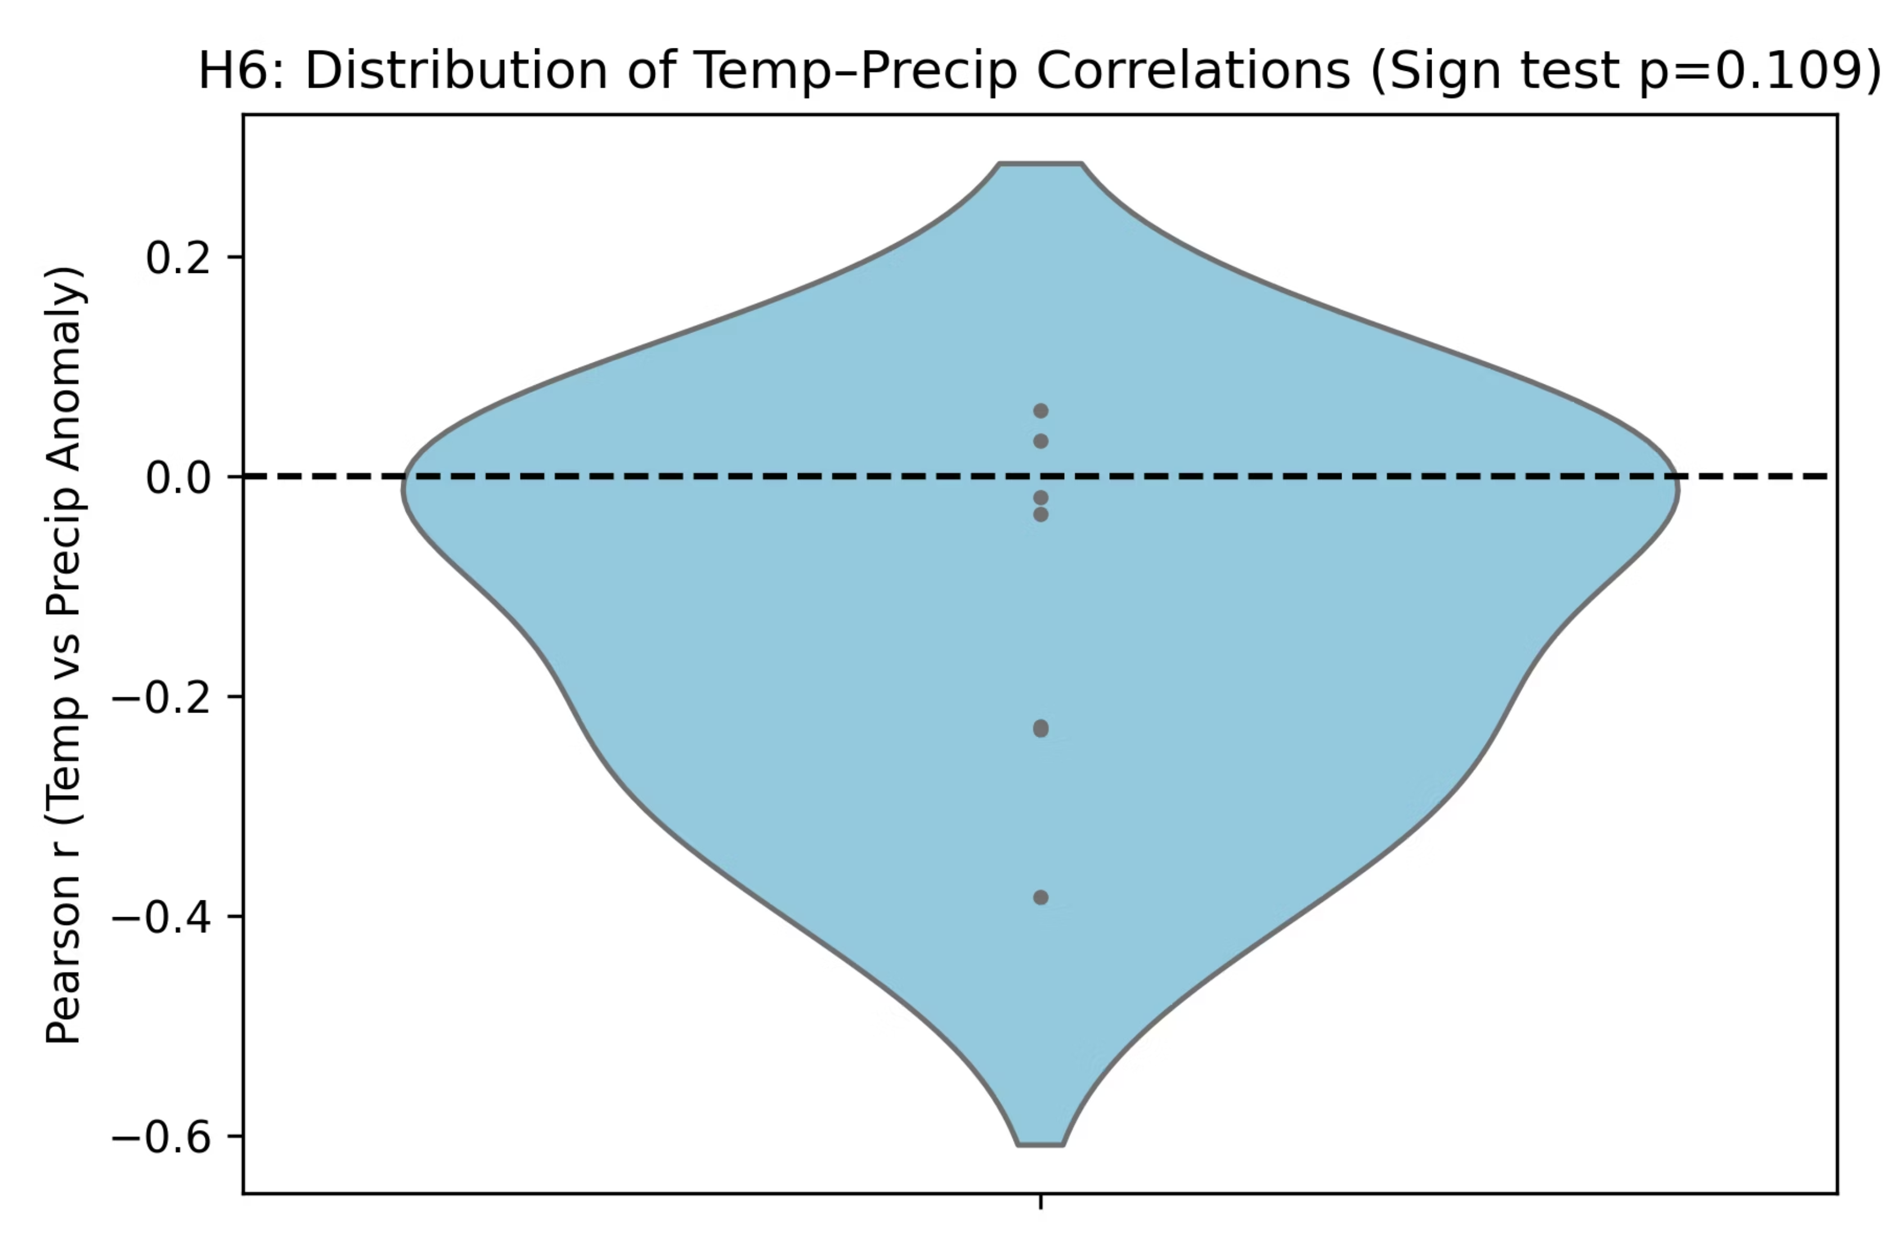
Conclusion: ❌ Disproved globally. The convective feedback mechanism is specific to regional climate dynamics.
Notes:
Figures:
“Scatter plots slope downward for New Delhi and Mumbai; the violin chart’s median below zero shows a mild overall negative tendency.”
Conclusion: ❌ Disproved globally – Negative feedback exists only regionally, not everywhere.

Slide 14
Hypothesis 7 (H7): CO₂–Temperature Link
Is Rising CO₂ Driving Long-Term Warming?
Hypothesis: Rising global CO₂ levels correlate with long-term increases in city-level temperature across all seven
study locations.
1
2
Methodology
Key Finding
Analyzed global atmospheric CO₂ levels and city-level temperature data (2000-2024) across seven study locations, utilizing linear regression to identify correlations.
Global atmospheric CO₂ increased from ~370 ppm to ~425 ppm over the study period. All study cities showed parallel warming trends, confirming the local manifestation of global warming.
Linear Regression results confirm CO₂ as a statistically significant driver of warming:
City
Regression Coefficient (β_CO₂)
Model Fit (R²)
New York
0.032 (p < 0.001)
0.84
New Delhi
0.033 (p < 0.001)
0.88
Mumbai
0.028 (p < 0.001)
0.79
Notes:
Speaking Notes:
“We merged global CO₂ data from Mauna Loa with each city’s temperature anomalies. Regression coefficients for CO₂ are all positive and highly significant (p < 0.001, R² ≈ 0.8). This shows higher CO₂ concentrations align with rising temperatures.”

Slide 15
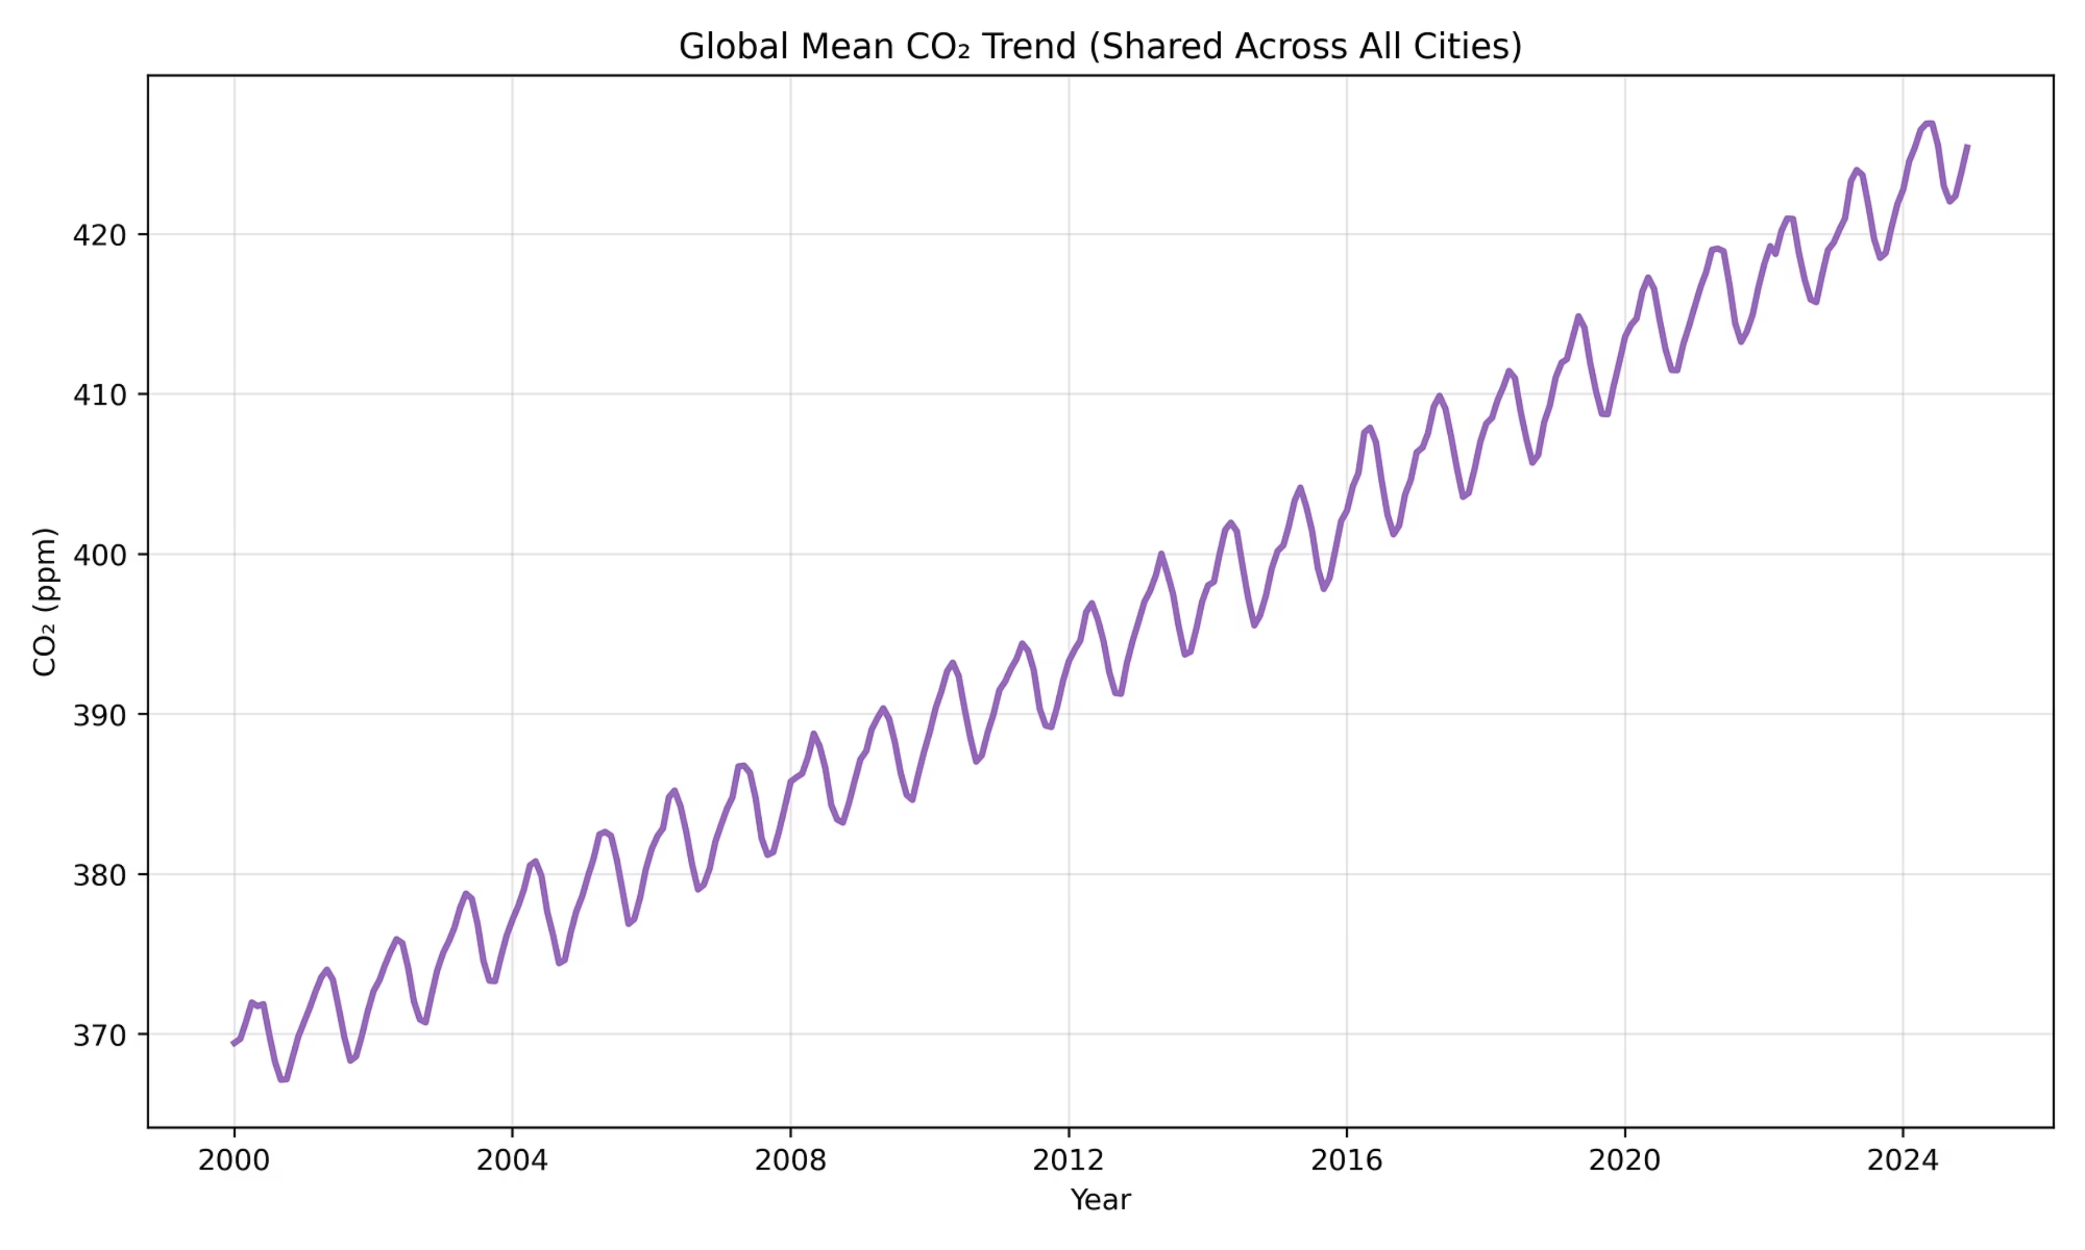
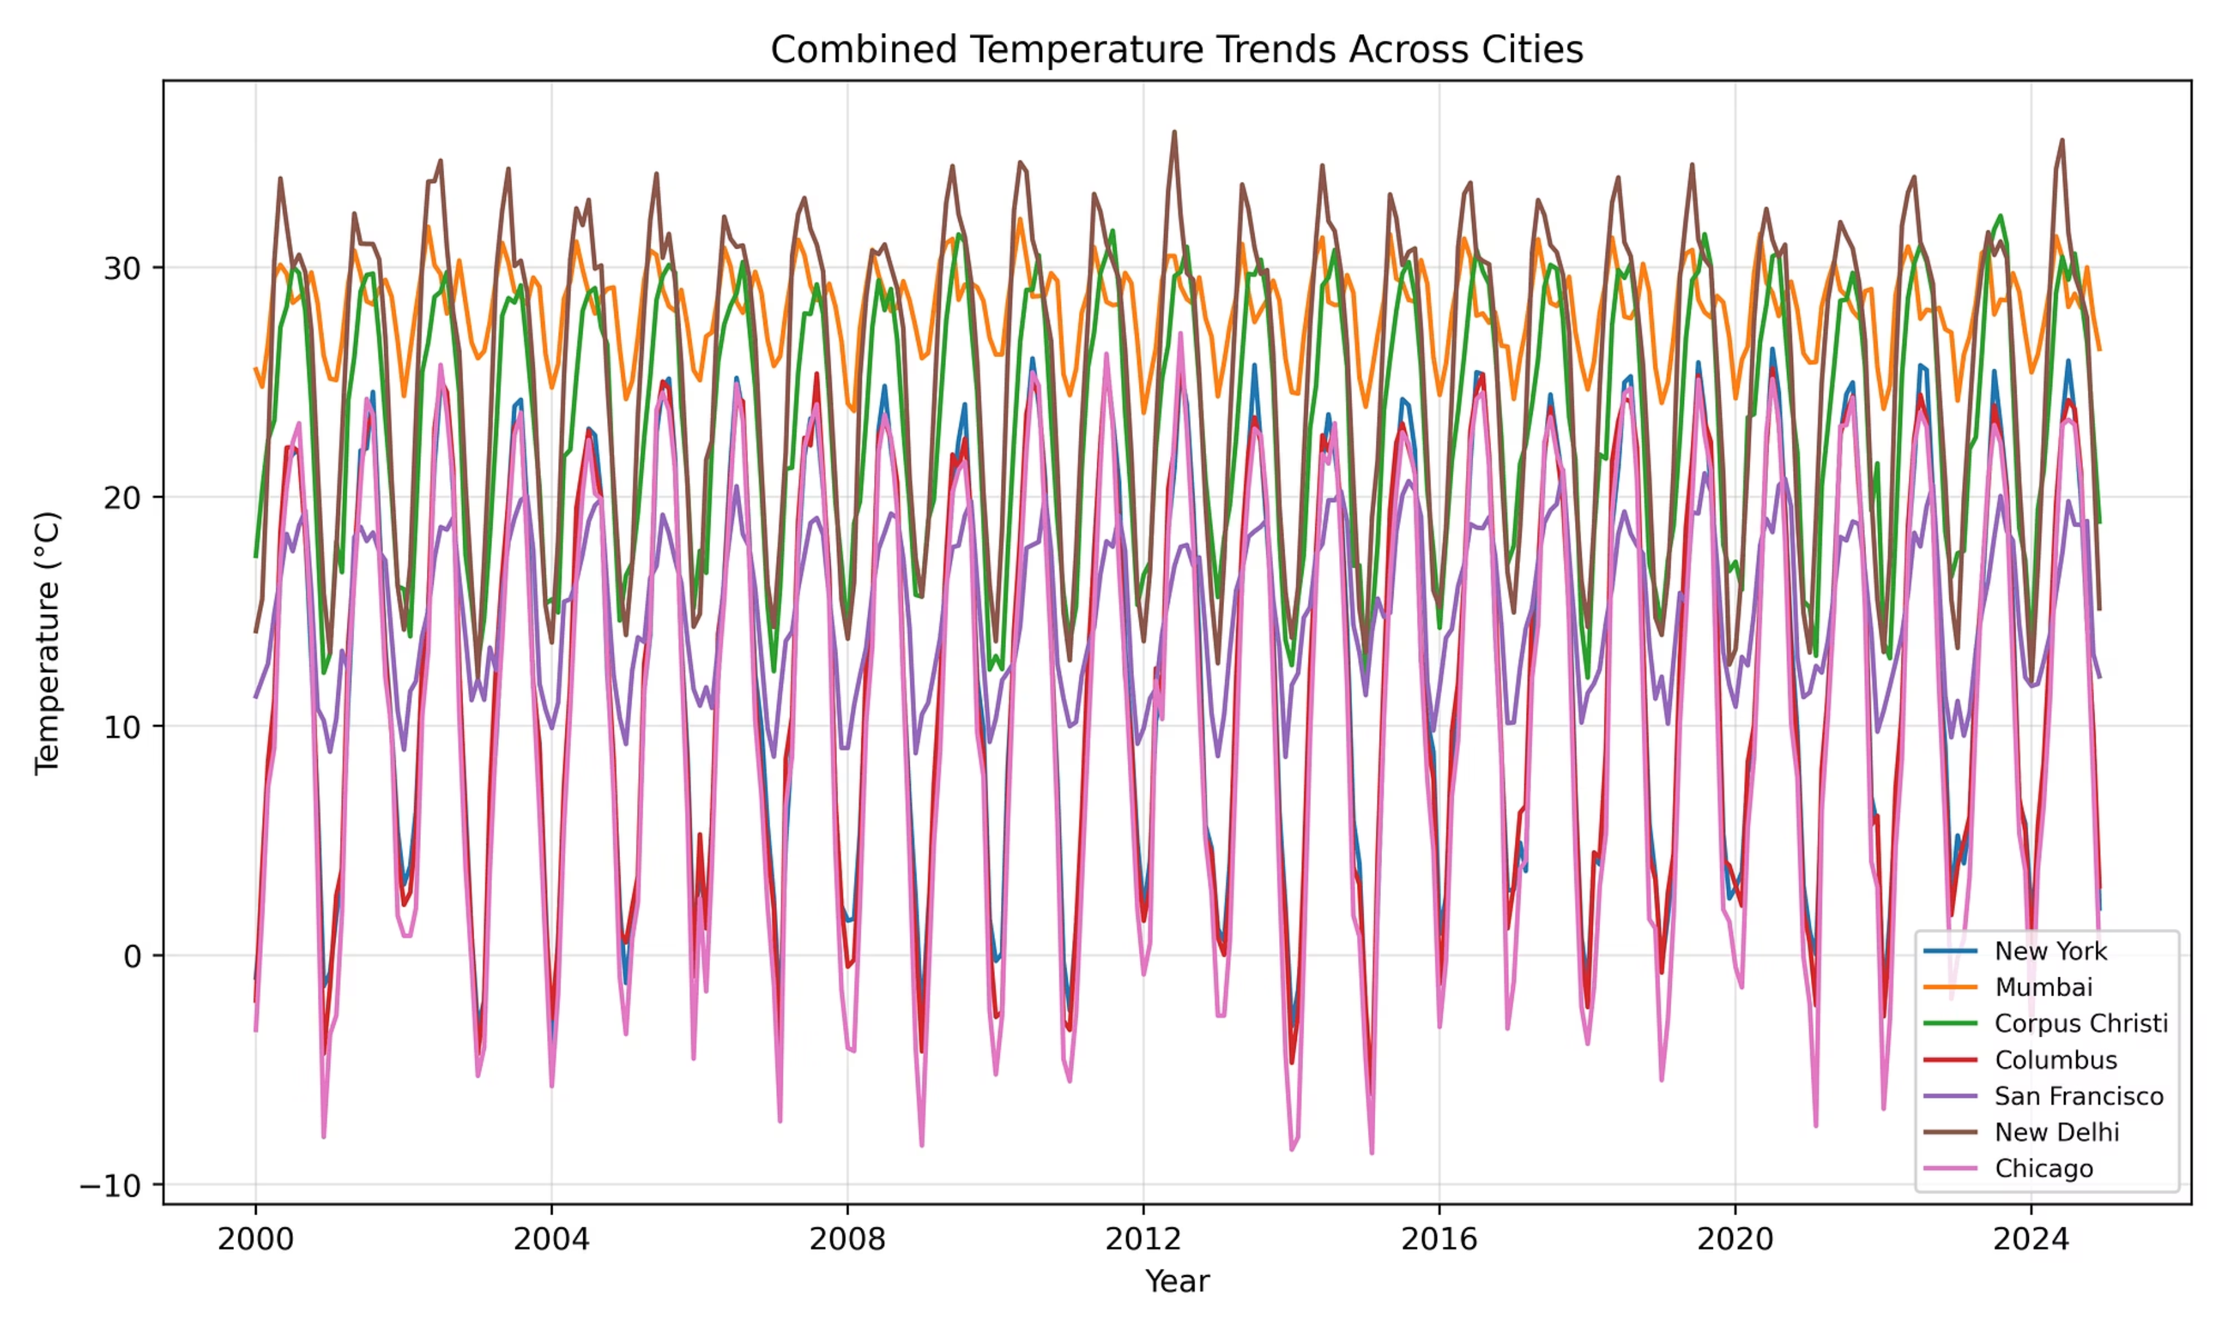
Conclusion: ✅ Proved. Rising CO₂ is robustly linked to long-term temperature increase across diverse climate zones.
Notes:
Figures:
“On the left, every city’s temperature trend climbs upward from 2000 to 2024. On the right, global CO₂ increases from 370 ppm to 425 ppm, mirroring the warming trend.”
Conclusion: ✅ Proved – CO₂ rise is a statistically significant driver of warming across all cities.

Slide 16
Hypothesis 8 (H8): Point vs Grid Consistency
Point Data vs. Gridded Averages: Which Tracks Better?
Hypothesis: Temperature point data track gridded averages more closely than precipitation, indicating differing
spatial consistency.
1
2
Methodology
Key Findings
This study involved comparing point data measurements for temperature and precipitation with corresponding gridded average datasets.
The statistical analysis reveals a stark difference: temperature correlates almost perfectly with gridded values (R² = 0.98), while precipitation shows only moderate correlation (R² = 0.58).
Statistical methods, including R² (coefficient of determination) and RMSE (Root Mean Square Error), were used to quantify the consistency and spatial variability between the point data and gridded averages. P-values were also calculated to determine statistical significance.
This suggests that temperature is spatially smoother and more uniformly distributed, whereas rainfall is highly localized and variable.
Comparison of Point Data vs. Gridded Averages:
Metric
Temperature
Precipitation
R²
0.98
0.58
RMSE
0.9°C
25 mm
p-value
<0.01
<0.01
Notes:
“We compared R² and RMSE between city-point data and regional grid averages. Temperature shows R² ≈ 0.98 vs 0.58 for precipitation, confirming smoother spatial behavior.”

Slide 17
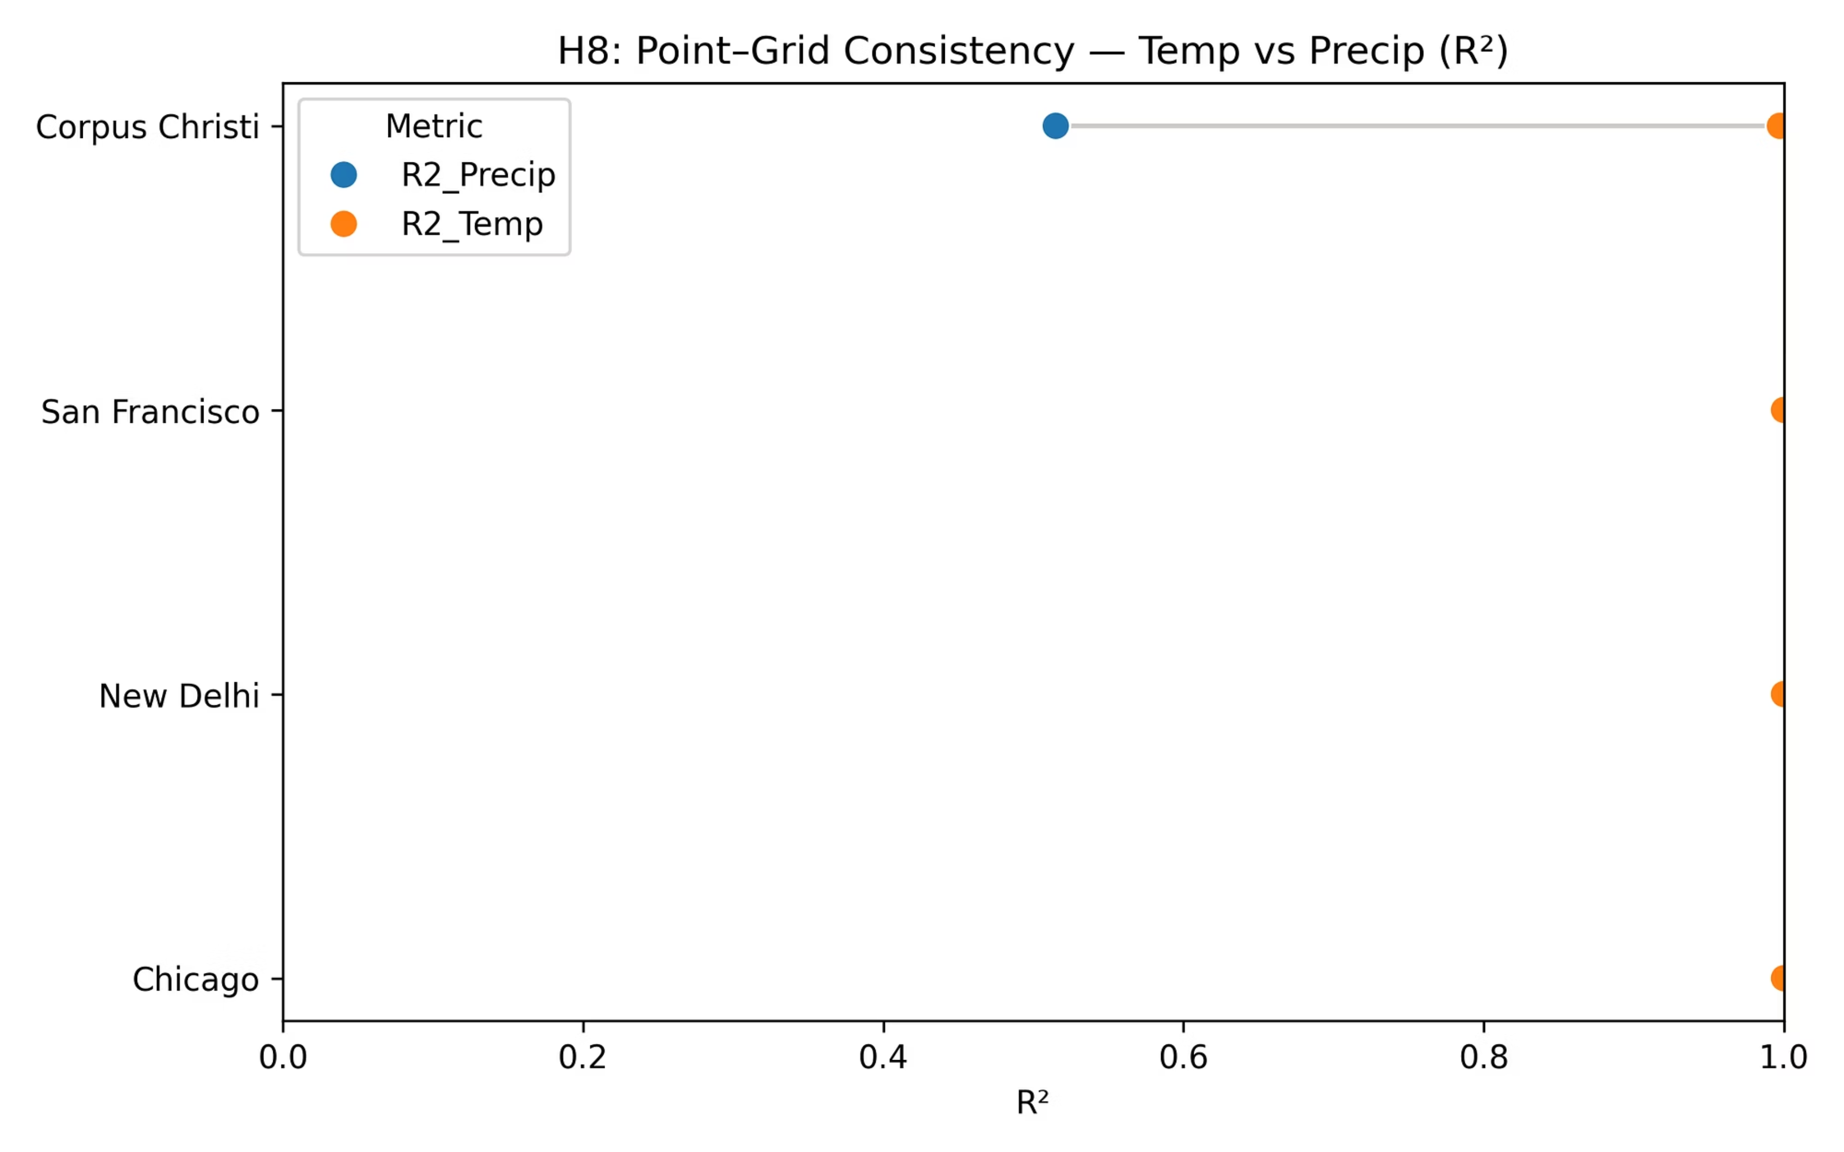
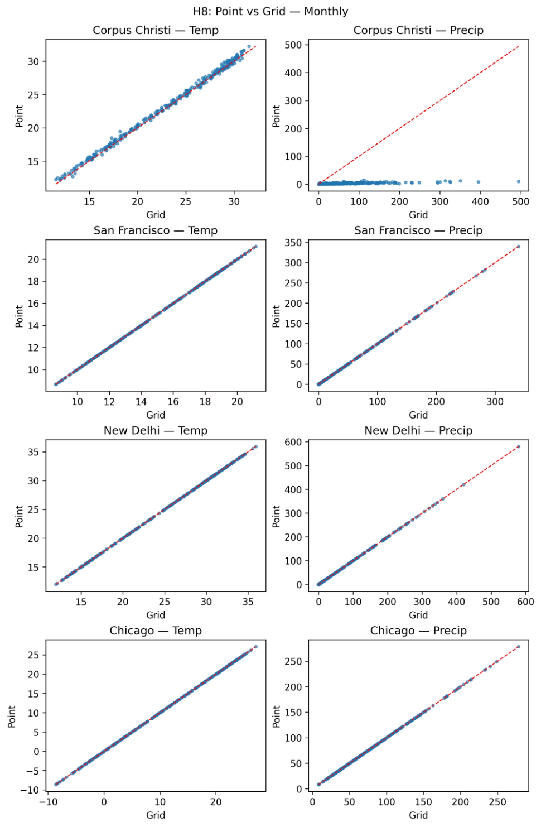
Conclusion: ✅ Proved. Temperature aligns significantly better with gridded datasets due to its smoother spatial distribution,
while precipitation exhibits greater localized variability.
Notes:
Figures:
“In the dumbbell chart, temperature lines sit near 1, while precipitation lags below 0.6. Scatter plots also show tight clustering for temperature but broad scatter for rainfall.”
Conclusion: ✅ Proved – Temperature is spatially smoother and more consistent than precipitation.

Slide 18

Questions & Discussion
Thank you for your attention to our analysis of global climate patterns. We now open the floor for your questions, comments, and insights.
Your engagement is vital as we collectively work towards a deeper understanding of climate science and its implications.

